Slide 1
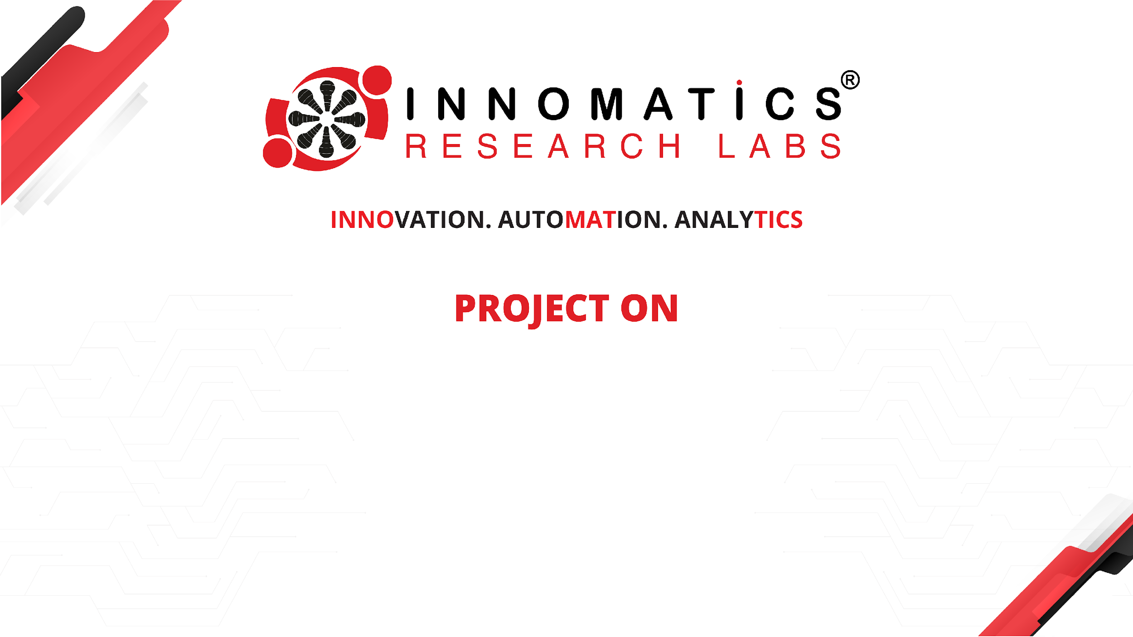
NOTE TAKING APPLICATION
Prepared By – Siddhi Vijay Farakate

Slide 2
About me
My name is Siddhi and completed Bachelor's degree in Mechanical Engineering (BE). Despite my engineering background, I developed a keen interest in the field of Data Science. The reason behind my inclination towards Data Science is its ability to uncover valuable insights from data, which can be applied across various industries. I see it as a powerful tool to analyze and interpret information, ultimately aiding in better decision-making. While my formal education is in mechanical engineering, I believe that learning Data Science will complement my skills and open up new opportunities for me to contribute meaningfully in today's data-driven world.

Slide 3
Task:
Refactor the existing codebase and ensure the proper functioning of the Note Taking Application. Document all identified bugs during the debugging process. Remember, the task is not about recreating the app from scratch. Your goal is to fix the already existing codebase and make the application work as intended.

Slide 4
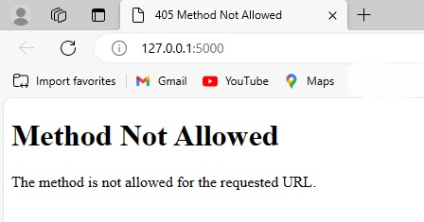
After running the app, we get error like Method not Defined

Slide 5
Identification of Bugs:
Bug 1: Incorrect request method defined in the Flask route
Bug 2: Incorrect Flask request object used to obtain data
Bug 3: There is no ‘If’ condition
Bug 4: Form attribute Action is empty/missing
Bug 5: Submit type attribute is missing

Slide 6
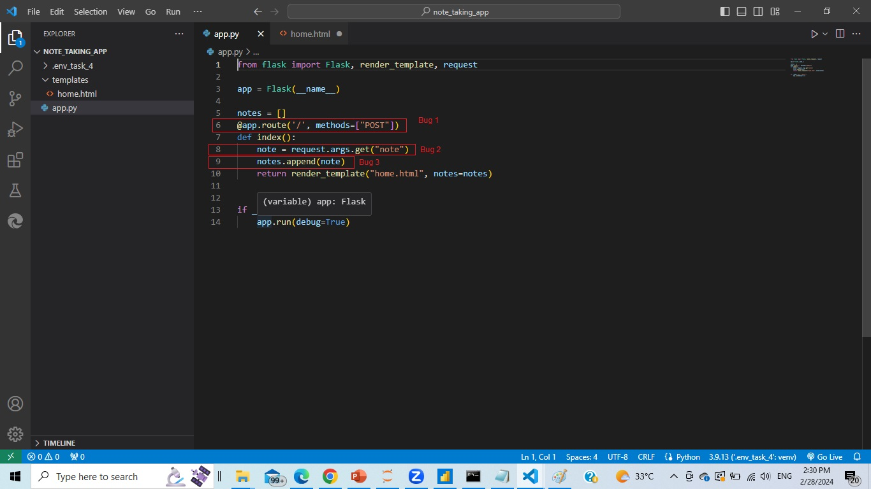
Bugs finding in the Application

Slide 7
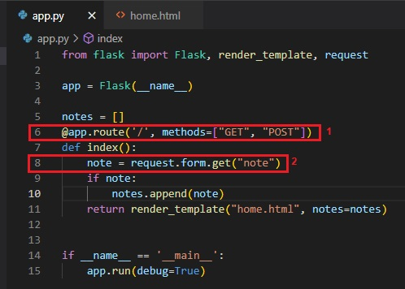
Fixing Bugs in the Application

Slide 8
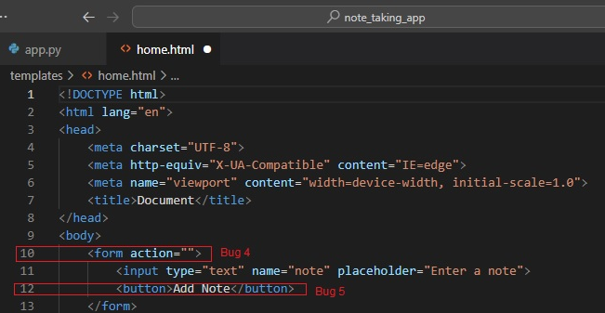
Bugs finding in the HTML

Slide 9
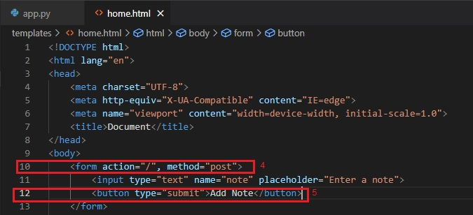
Fixing bugs in the HTML

Slide 10
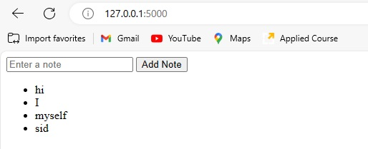
After Fixing all the Bugs:

Slide 11

THANK YOU

